Slide 1
Race to Empty on the DAO:
A Recursive Call Attack
Wesley Harmon
CS453 Emory University
Notes:
1

Slide 2
A quick recap: What do we need to know?
Ethereum blockchain
Implements event driven programming using callbacks
Callbacks can compromise security
Smart contracts // MOST IMPORTANT //
The code is the law!
“The DAO”
A GoFundMe app for projects
~15% of all Ether was invested
Notes:
2

Slide 3


SMART CONTRACTS
GPS coordinate A
GPS coordinate B
if (GPS_A(blue)==GPS_A(yellow) && GPS_B(blue)==GPS_B(yellow)
after B has been reached) {
PROFIT!
}
How can we set up a system that guarantees compensation?
PROGRAMMABLE, IMMUTABLE!
Notes:
3

Slide 4
DEMO
Notes:
4

Slide 5
THE TECHNIQUE
Construct wallet w/ a default function that call “splitDAO” n times
Create a split proposal, set recipient address to malicious wallet
?????
PROFIT!
Notes:
5

Slide 6
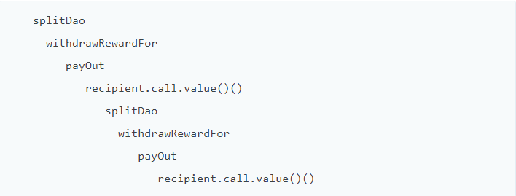
THE TECHNIQUE
Notes:
6

Slide 7

THE ACTUAL CODE: splitDAO()
function splitDAO (uint _proposalID, address _newCurator) noEther onlyTokenholders returns (bool _success)
{
...
uint fundsToBeMoved = (balances[msg.sender] * p.splitData[0].splitBalance) /
p.splitData[0].totalSupply;
if (p.splitData[0].newDAO.createTokenProxy.value(fundsToBeMoved)(msg.sender) == false)
throw;
...
Transfer(msg.sender, 0, balances[msg.sender]);
withdrawRewardFor(msg.sender); // PROFIT
totalSupply -= balances[msg.sender]; balances[msg.sender] = 0;
paidOut[msg.sender] = 0;
return true;
}
Notes:
7

Slide 8
withdrawRewardFor()
function withdrawRewardFor(address _account) noEther internal returns (bool _success) {
if ((balanceOf(_account) * rewardAccount.accumulatedInput()) / totalSupply < paidOut[_account])
throw;
uint reward = (balanceOf(_account) * rewardAccount.accumulatedInput()) / totalSupply - paidOut[_account];
if (!rewardAccount.payOut(_account, reward))
Throw;
paidOut[_account] += reward;
return true;
}
Here’s the culprit
The rewardAccount is managed by the attacker,
The bad stuff happens when this function gets called…
Notes:
8

Slide 9
USEFUL INFORMATION
Creator of the malicious DAO: 0x4a574510c7014e4ae985403536074abe582adfc8
Start of the drain: 2016–06–17 03:34:48 UTC, block 1718497
The malicious child DAO aka “The Dark DAO”: 0x304a554a310c7e546dfe434669c62820b7d83490
Malicious token holders aka “Dark token holders”. These are the accounts that control the malicious DAO: 0xc0ee9db1a9e07ca63e4ff0d5fb6f86bf68d47b890xf835a0247b0063c04ef22006ebe57c5f11977cc4
Curator of the malicious DAO and creator of the malicious proposal: 0xb656b2a9c3b2416437a811e07466ca712f5a5b5a
The malicious proposal from which the attack was launched: #59, aka “lonely, so lonely”, 2016–06–08 05:38:01 UTC, before the recursion call bug went public on 2016–06–10
Notes:
9

Slide 10
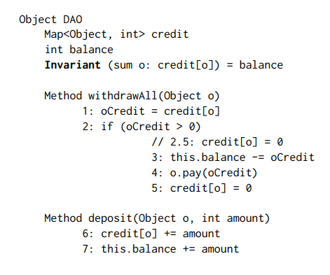
SOLUTIONS?
An obvious one, change the code!
Other types of solutions?
Design contracts to be effectively callback-free
Addressing the communities concerns
Notes:
10

Slide 11
EFFECTIVELY CALLBACK-FREE OBJECTS
dynamicallyECF
Perform an “equivalent” execution without callbacks, compare states and results
staticallyECF
Check that all possible executions of an object are dynamically ECF
Languages like Solidity support Turing complete languages, therefore determining sECF is undecidable
dECF is more applicable here anyways
Notes:
11

Slide 12
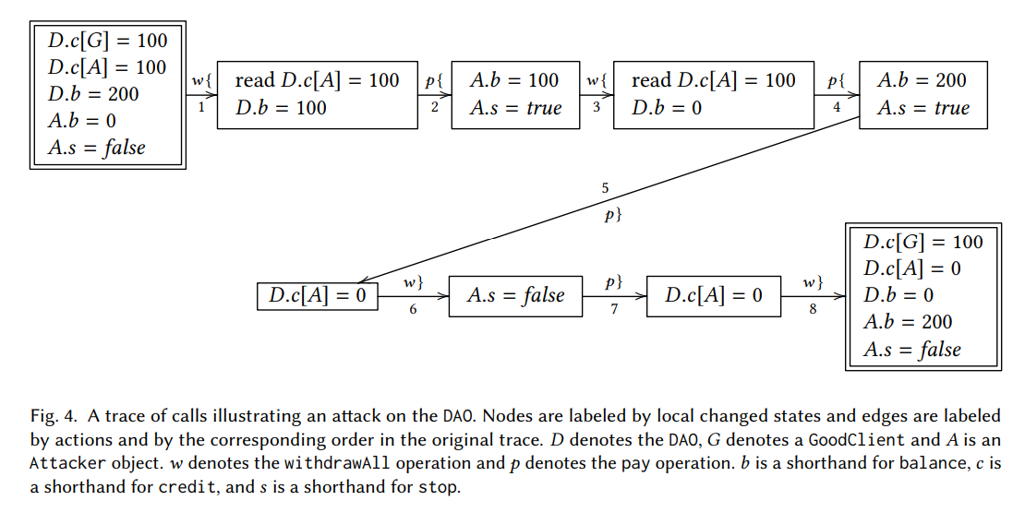
TRACING THE CALLS
Notes:
12

Slide 13
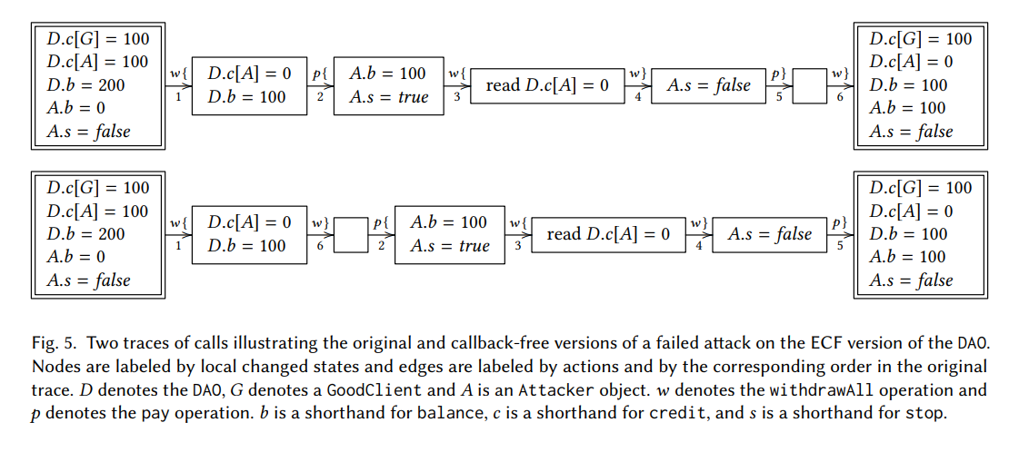
A NAÏVE APPROACH TO DETECTION
Notes:
13

Slide 14
THE APPROACH APPROACHES
Soft-fork:
Just freeze all the assets and problem solved?
Hard-fork:
Try to set up a new contract only for withdrawing
Allow tokenholders to withdraw
The DAO dissolves
Notes:
14

Slide 15
What to do next time?
A language to end all languages is needed (with ECF objects, etc.). If we can't have that right now…
All calls to untrusted addresses should have a gas limit
Balances should be updated before a send, not after one
Events should probably have a Log prepended to their name.
The splitDAO function should keep permanent track of the status of each possible splitter, not just through token tracking (balances, credit, accumulatedInput )
Notes:
15

Slide 16
THE TAKEAWAYS + QUESTIONS?
Decentralized apps must be rigorously checked for bugs
Callbacks are NOT the future
The ultimate war between white hats and black hats!
Smart contracts represent something bigger: DIGITAL LAW
Lessons sometimes have to be learned the hard way
The applications are endless, and awesome!
Notes:
16

Slide 17
SOURCES
http://www.cs.tau.ac.il/~shellygr/pubs/2018-popl-1.pdf
https://medium.com/@MyPaoG/explaining-the-dao-exploit-for-beginners-in-solidity-80ee84f0d470
http://vessenes.com/deconstructing-thedao-attack-a-brief-code-tour/
https://medium.com/@oaeee/the-rise-of-the-dark-dao-72b21a2212e3
https://ethereum.github.io/browser-solidity/#version=soljson-v0.4.18+commit.9cf6e910.js
Notes:
17

